Slide 1


Michal Precikowski
08/19/2025

Slide 2

Outline
Executive Summary
Introduction
Methodology
Results
Conclusion
Appendix

Slide 3
Executive Summary
Methods in brief: I combined targeted web scraping with the SpaceX REST API to create a consolidated dataset, which I then standardized using data wrangling. I developed interactive folium maps and a Plotly Dash dashboard, used plots and SQL to investigate patterns, and trained and adjusted classification models to forecast launch success.
Brief results: Lighter payloads performed well, and success rates tended to be higher for specific orbits and launch locations. EDA helped to understand which features are the best option to define the success of launchings. The best model used payload, orbit, booster version, and site to accurately estimate the success probability.

Slide 4
Introduction
To compete with the well-known SpaceX, the new company Space Y is taking action. By reducing marginal launch costs, Falcon 9's reusable architecture has changed the way people can access orbit. I convert mission-level records into useful insight for this project: Which elements are most beneficial to success? What is the relationship between launch site, orbit, and payload mass? Can those relationships be predicted to new launches using a predictive model?

Slide 5

Section 1

Slide 6
Methodology
Executive Summary
Data collection methodology:
The SpaceX API was used to request rocket launch data
Falcon 9 historical launch records were scraped from Wikipedia
Perform data wrangling
Based on the collected data, a landing outcome label was created to represent the outcome of each launch
Perform exploratory data analysis (EDA) using visualization and SQL
Perform interactive visual analytics using Folium and Plotly Dash
Perform predictive analysis using classification models

Slide 7
Data Collection
Data sets were collected using:
The Space X API available at https://api.spacexdata.com
Web scraping from a Wikipedia page titled “List of Falcon 9 and Falcon Heavy Launches”

Slide 8
Data Collection – SpaceX API
The SpaceX REST API allows to request launch, rocket, core, capsule, starlink, launchpad, and landing pad data
HTTP GET requests were sent to request data from SpaceX API
Dataset was constructed using the extracted properties for Falcon 9 launches, including the booster name, name of the launch site and others
Dataset was exported to a CSV file
Completed notebook available at https://github.com/MagicMagic99/DataCollectionAPI-Michal/blob/main/jupyter-labs-spacex-data-collection-api-Michal%20(1).ipynb

Slide 9
Data Collection – SpaceX API
Step 1
Step 2
Step 3
Collect data from the SpaceX REST API and parse the response into a Pandas dataframe
Filter data for Falcon 9 launches and extract meaningful attributes
Deal with missing values and save the dataset to a CSV file

Slide 10
Data Collection - Scraping
Falcon 9 historical launch data were collected by performing web scraping a Wikipedia page
Data was extracted with BeautifulSoup library and converted into a Pandas data frame
Data was saved to a CSV file
Completed notebook available at https://github.com/MagicMagic99/Webscraping-Michal/blob/main/jupyter-labs-webscraping-Michal.ipynb

Slide 11
Data Collection - Scraping
Step 1
Step 2
Step 3
Collect data from a Wikipedia page
Extract data using the BeautifulSoup library
Export data to a CSV file

Slide 12
Data Wrangling
Exploratory Data Analysis(EDA) was performed to find patterns in the data
Number of launches on each site was determined, occurrences of each orbit and mission outcome per orbit were calculated
A landing outcome label was created, representing the outcome of each launch
Completed data wrangling related notebook available at https://github.com/MagicMagic99/Data-wrangling-Michal/blob/main/labs-jupyter-spacex-Data%20wrangling-Michal.ipynb
Perform EDA
Generate Summaries
Create Landing Label

Slide 13
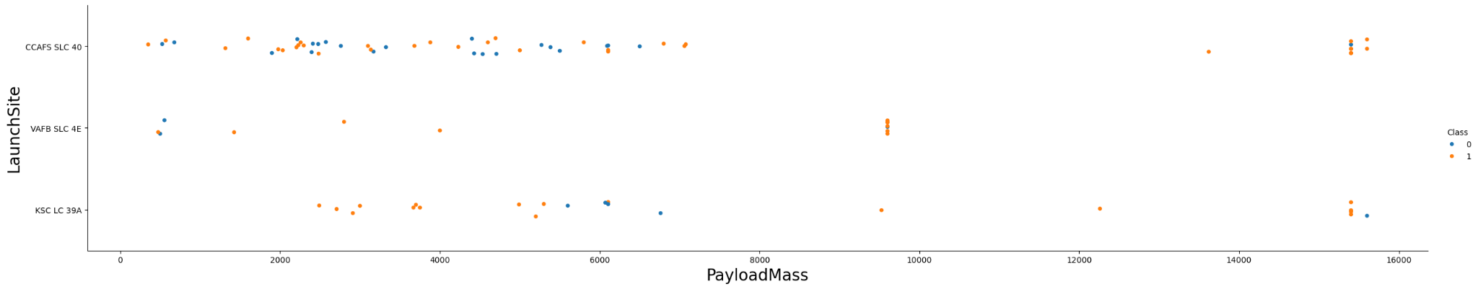
EDA with Data Visualization
For data visualization, scatter point charts, bar chart and line chart were used
The scatter point charts allowed to visualize the relationships between pair of values, e.g. payload mass and launch site
Completed EDA with data visualization notebook available at https://github.com/MagicMagic99/edadataviz-Michal/blob/main/edadataviz-Michal.ipynb

Slide 14
EDA with SQL
Set of SQL queries were performed to select:
Names of the unique launch sites in the space mission
Launch sites begin with the string 'CCA' limited to 5 records
Total payload mass carried by boosters launched by NASA (CRS)
Average payload mass carried by booster version F9 v1.1
Date when the first successful landing outcome in ground pad was achieved
Names of the boosters which have success in drone ship and have payload mass greater than 4000 but less than 6000
Total number of successful and failure mission outcomes
booster_versions that have carried the maximum payload mass
Records which will display the month names, failure landing_outcomes in drone ship ,booster versions, launch_site for the months in year 2015.
Rank the count of landing outcomes (such as Failure (drone ship) or Success (ground pad)) between the date 2010-06-04 and 2017-03-20, in descending order.
Completed EDA with SQL notebook available at https://github.com/MagicMagic99/eda-sql-coursera_sqllite-Michal/blob/main/jupyter-labs-eda-sql-coursera_sqllite-Michal%20(1).ipynb

Slide 15
Build an Interactive Map with Folium
Circles, markers, marker clusters and lines were used
Circle to highlight area with a text label on a specific coordinate
Marker to indicate a point on map
MarkerCluster to simplify a map containing many markers having the same coordinate
Lines to indicate distances between two coordinates
Completed interactive map with Folium map available at https://github.com/MagicMagic99/folium_lab_launch_site_location-Michal/blob/main/lab_jupyter_launch_site_location-Michal.ipynb

Slide 16
Build a Dashboard with Plotly Dash
Pie chart and scatter chart were used to visualize data
Pie chart to show the total successful launches count for a site or all sites
Scatter chart to show the correlation between payload and launch success
Those plots allowed to identify the most successful launch sites according to payload mass
Completed Plotly Dash lab available at https://github.com/MagicMagic99/spacex-dash-Michal/blob/main/spacex-dash-app%20(1).py

Slide 17
Predictive Analysis (Classification)
Building several classification models (Logistic Regression, Decision Trees, and SVM) using features like payload, orbit, and launch site. Each model was tuned and evaluated on test data with metrics such as accuracy and confusion matrices. After comparison, the best-performing model was selected for its balanced accuracy and ability to generalize.
https://github.com/MagicMagic99/SpaceX_Machine-Learning-Prediction_Part_5-Michal/blob/main/SpaceX_Machine%20Learning%20Prediction_Part_5-Michal.ipynb
Data Preparation
Model Building
Evaluation
Model Selection

Slide 18
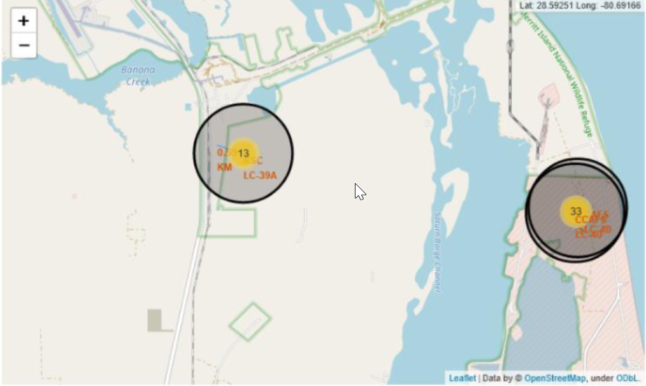
Results
Exploratory Data Analysis
Lighter payloads → higher success rates.
Heavy payloads more likely to fail.
LEO orbits showed the strongest success ratios.
Success rates improved steadily year by year.
Interactive Analytics 5. Folium map displayed all launch sites with success/failure markers. 6. Zoomed maps showed sites in relation to highways, railways, and coastlines. 7. Plotly Dash dashboard allowed filtering by payload range, orbit, and site. 8. Interactive tools confirmed patterns seen in SQL queries and plots.
Predictive Analysis 9. Models tested: Logistic Regression, Decision Tree, SVM. 10. Best-performing model achieved high accuracy and balanced outcomes. 11. Key predictors: payload mass, orbit type, and launch site.

Slide 19

Section 2

Slide 20
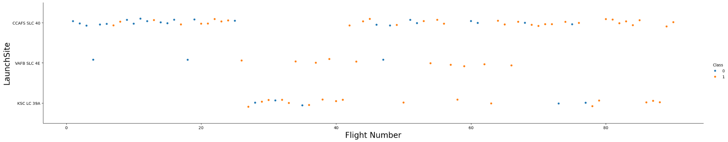
Flight Number vs. Launch Site
The plot shows that the CCAF5 SLC 40 launch site had the highest number of successful launches recently
The success ratio has improved over time, at the beginning majority of the launches were unsuccessful

Slide 21
Payload vs. Launch Site
Payloads around 4,000kg, 9,000kg and 16,000 kg have very good success rate on more than one launch site
For the VAFB-SLC launchsite there are no rockets launched for heavy payload mass (greater than 10,000kg)

Slide 22
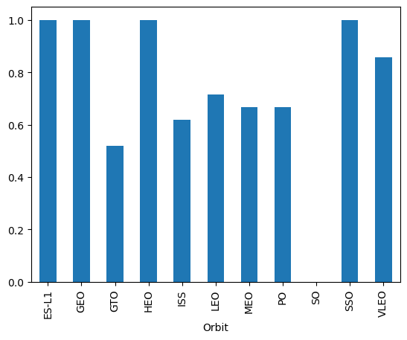
Success Rate vs. Orbit Type
The highest success rate were seen on:
ES-L1
GEO
HEO
SSO
SO orbit success rate is 0 which means there were no launches related to that orbit type or all launches were unsuccessful

Slide 23
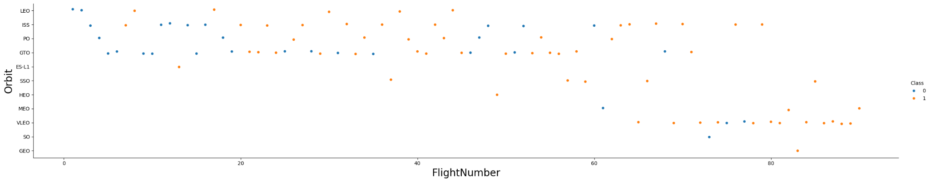
Flight Number vs. Orbit Type
VLEO orbit was related to high number of recent successful flights
Four orbit types (LEO, ISS, PO, GTO) were mainly picked for first 60 missions

Slide 24
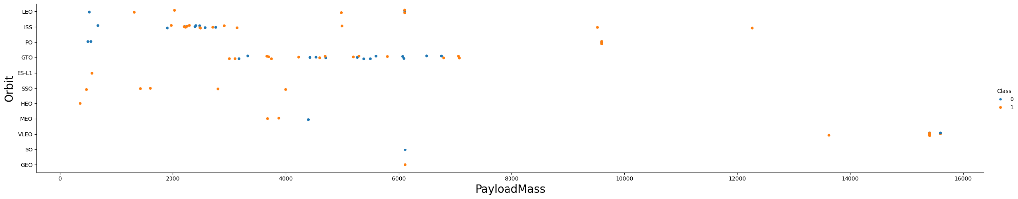
Payload vs. Orbit Type
With heavy payloads the successful landing or positive landing rate are more for Polar,LEO and ISS.
No visible relation between payload and success rate to orbit GTO
Impossible to indicate payload relation with success rate to some orbits, e.g. SO, GEO, due to few launches

Slide 25
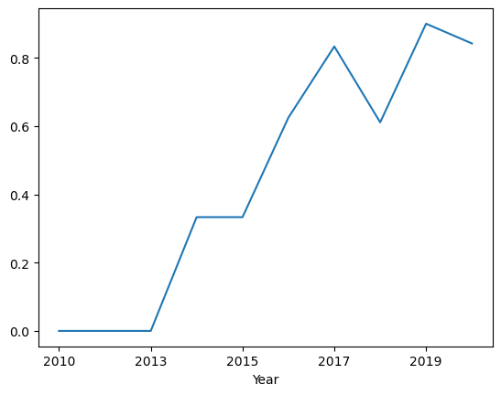
Launch Success Yearly Trend
No successful launches until 2013
Success rate increased significantly from 2013 to 2017
Decline in 2017 could indicate testing launches to new orbit types or different payloads

Slide 26
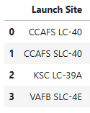
All Launch Site Names
There are four lauching sites:
Listing the distinct launch sites shows all the locations SpaceX has used, and it forms the base for doing site-by-site comparisons later in the analysis.

Slide 27
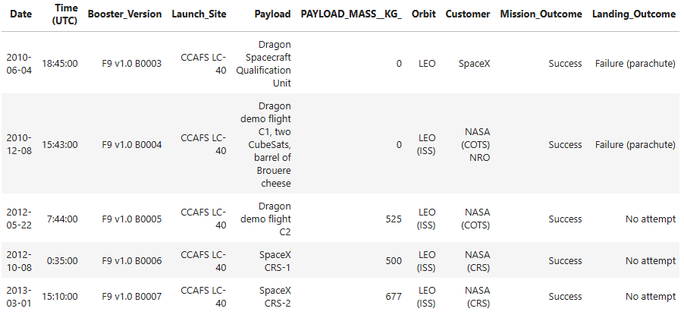
Launch Site Names Begin with 'CCA'
5 records where launch sites begin with `CCA`
Filtering with the CCA% pattern pulls up the Cape Canaveral pads, which are some of the most frequently used launch sites in the dataset.

Slide 28
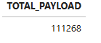
Total Payload Mass
Total payload carried by boosters from NASA
Adding up payload mass for NASA missions shows how much cargo the agency has launched on Falcon 9.

Slide 29
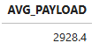
Average Payload Mass by F9 v1.1
The average payload mass carried by booster version F9 v1.1
Taking the average payload for the F9 v1.1 booster shows what that version could handle compared to newer ones.

Slide 30
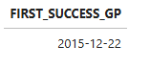
First Successful Ground Landing Date
First successful landing outcome on ground pad
Finding the date of the first successful ground landing is important because it marks the point when SpaceX proved boosters could be reused. This milestone helps set the timeline for how their reusability efforts developed.

Slide 31
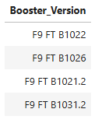
Successful Drone Ship Landing with Payload between 4000 and 6000
List the names of boosters which have successfully landed on drone ship and had payload mass greater than 4000 but less than 6000
Checking for successful drone-ship landings in the 4–6 ton payload range shows how SpaceX managed heavier missions while still recovering boosters. It highlights the balance between carrying larger loads and maintaining reusability.

Slide 32
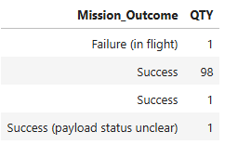
Total Number of Successful and Failure Mission Outcomes
The total number of successful and failure mission outcomes
Counting all successful and failed launches gives a clear picture of overall performance. It shows how many missions went as planned and how many didn’t, giving context for SpaceX’s progress.

Slide 33
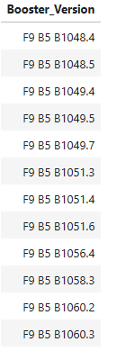
Boosters Carried Maximum Payload
Names of the boosters which have carried the maximum payload mass
Listing boosters that carried the heaviest payloads showcases edge-case performance and informs payload-risk hypotheses.

Slide 34
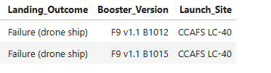
2015 Launch Records
Failed landing_outcomes in drone ship, their booster versions, and launch site names for in year 2015
A focused 2015 slice for drone-ship failures, including booster versions and sites, helps diagnose early-phase learning areas.

Slide 35
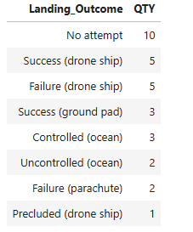
Rank Landing Outcomes Between 2010-06-04 and 2017-03-20
Ranking of all landing outcomes (such as Failure (drone ship) or Success (ground pad)) between the date 2010-06-04 and 2017-03-20, in descending order
Ranking the landing outcomes from this period shows the balance between successes and failures in SpaceX’s early years, giving context to how their recovery methods improved over time.

Slide 36

Section 3

Slide 37
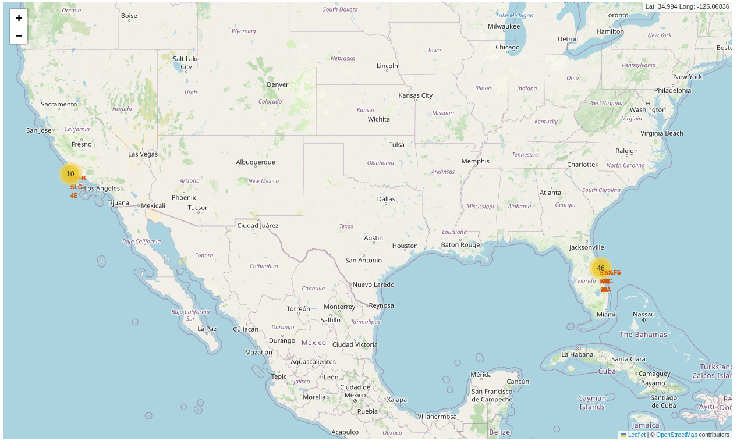
All launch sites
Launch sites are located near sea for safety, as rocket failures are less catastrophic over open water, and for logistics, as rocket components are easier to transport by ships.

Slide 38
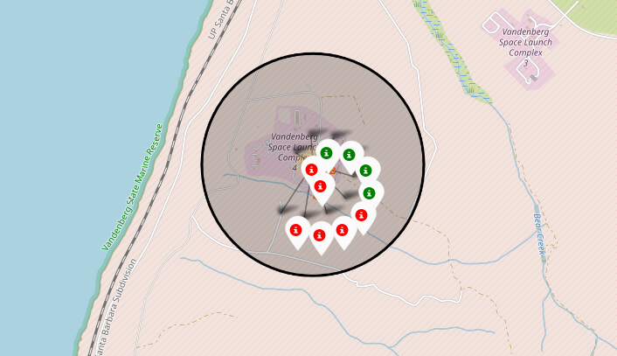
Launch outcomes by site
Launch outcomes for VAFB SLC-4E launch site
Green markers indicate successful launches and red markers indicate failures.

Slide 39
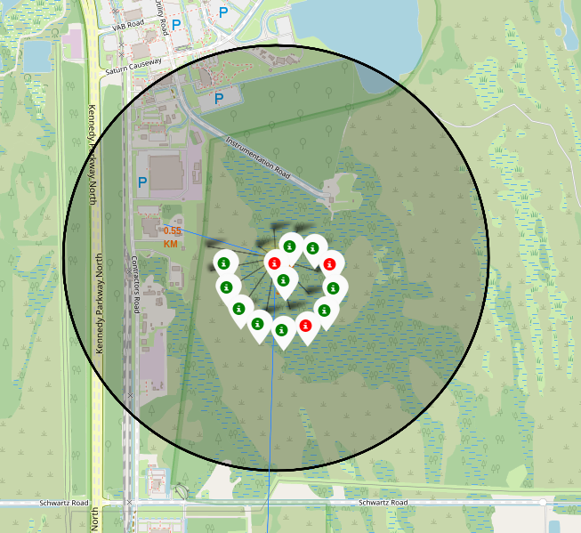
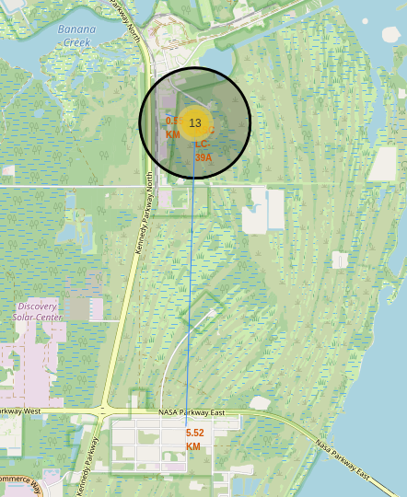
Logistics for KSC LC-39A launch site

Slide 40
Logistics for KSC LC-39A launch site
Launch site KSC LC-39A is located near railroad
Kennedy Parkway road facilitates the movement of equipment and personnel
To ensure safety, the launch site location is relatively far from houses

Slide 41

Section 4

Slide 42
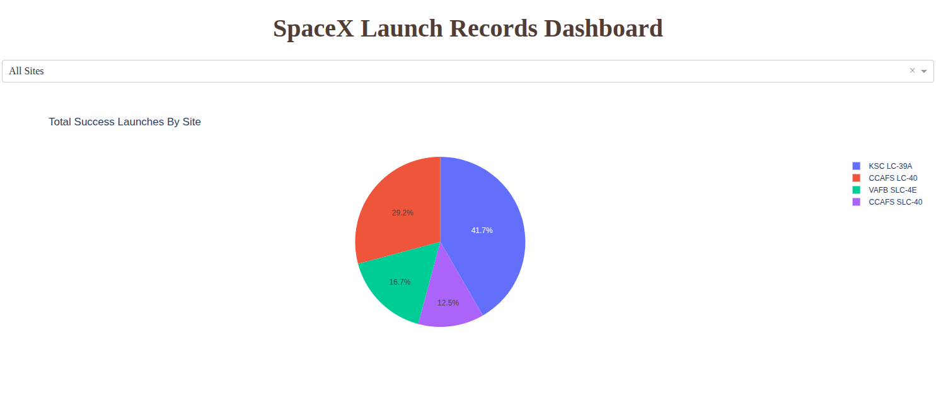
Successful launches for all sites
Success of SpaceX rocket launch depends significantly on the launch site, success rate ranges from 12.5% to 41.7%

Slide 43
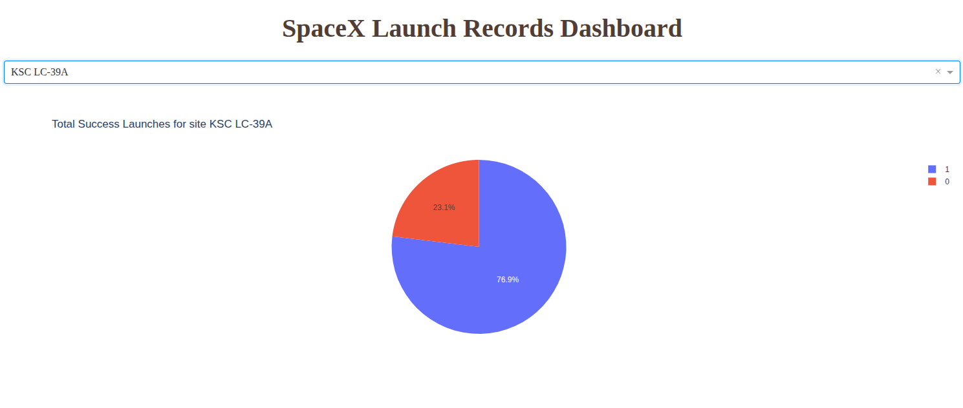
Launch site with highest launch success ratio
Kennedy Space Center (KSC LC-39A) launch site exhibits the highest launch success ratio at 76.9 %

Slide 44
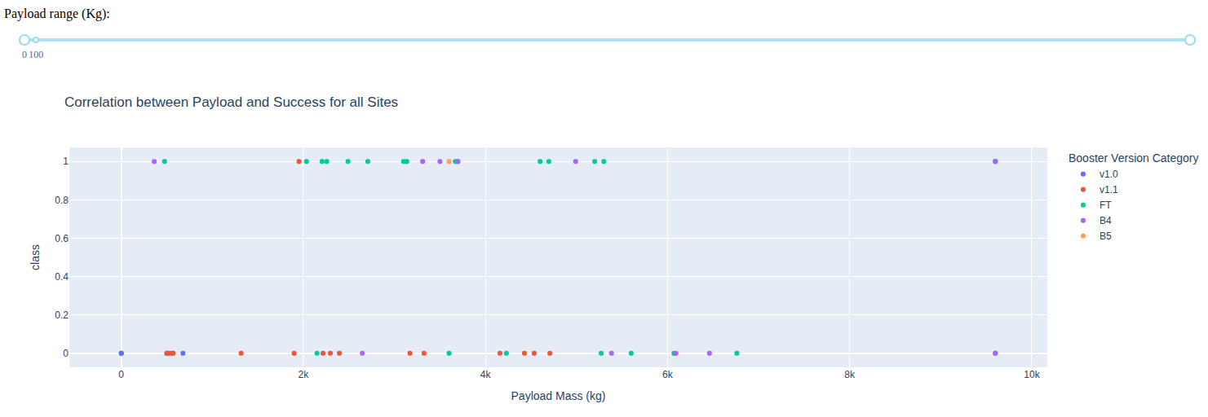
Payload vs launch outcome
Launches with payloads in range 2,000-4,000kg with FT boosters were the most successful among different payload and booster combinations

Slide 45
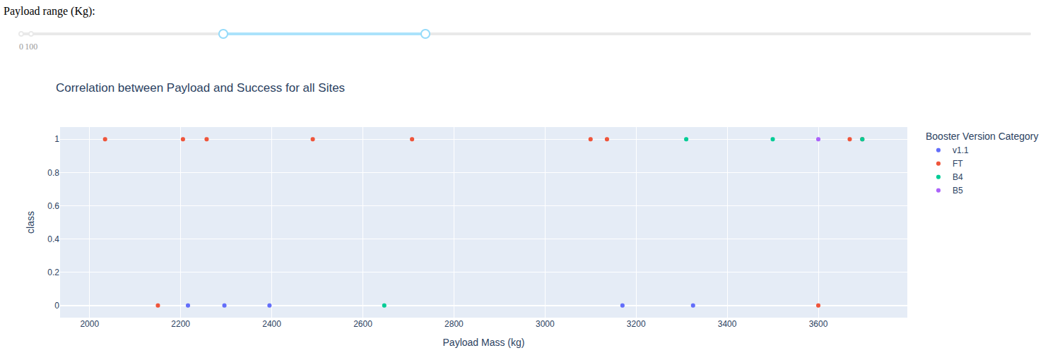
Payload vs launch outcome
For payloads over 2,000kg and under 3,200 kg FT boosters were the only successful ones
All launches with v1.1 boosters ended up with failure

Slide 46

Section 5

Slide 47
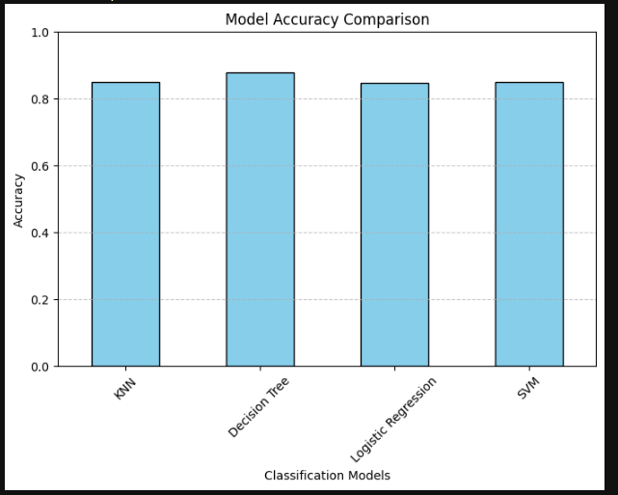
Classification Accuracy
The method that performs best is " Decision Tree " with a score of 0.8767857142857143

Slide 48
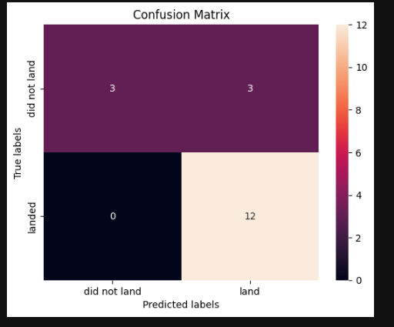
Confusion Matrix
The confusion matrix shows balanced performance across classes, with most errors occurring in edge cases (e.g., heavy payloads or challenging orbits). This aligns with domain expectations and suggests useful decision support for planning.

Slide 49
Conclusions
SpaceX’s launch data shows steady improvement in success rates year after year.
Lighter payloads and certain orbits (like LEO) consistently had higher chances of success.
Frequent use of the same launch sites led to more reliable results over time.
Booster reusability played a big role in driving down failures and improving consistency.
The predictive model confirmed these trends and proved useful for estimating future outcomes.
Overall, the project shows how data science can explain past results and help forecast what’s ahead.

Slide 50


